Slide 1
About JavaScript
David Tarvin, AIM Code School

Slide 2
What is JavaScript?
JavaScript is a scripting or programming language that allows for interactive web pages by enabling dynamic content such as:
Real-time content updates
Interactive maps
Form validation
Animated 2D/3D graphics
Scrolling video jukeboxes
Countless others

Slide 3
But what is it actually?
JavaScript is a lightweight, cross-platform, single-threaded, and interpreted or just-in-time compiled programming language well-known for the development of web pages, as well as its use in many non-browser environments

Slide 4
What does lightweight mean?
Lightweight programming languages are those which are designed to:
Consume minimal memory resources when its code or an application is running
Ease the implementation across platforms such as web, mobile, desktop, etc.
Have a minimalist, semantic, simple syntax to help in learning quickly

Slide 5
How is JavaScript lightweight?
It makes applications consume fewer resources than other language implementations
It runs on browsers without any dependencies
New features are constantly added so users need not write any new code, making it leaner on resources
It has a minimal set of language constructs, which can be leveraged to handle any requirement for a given application
Learning the language does not require a great deal of effort

Slide 6
What makes JavaScript cross-platform?
Originally designed to run in the browser
Now used for things such as:
Native application development
Virtual reality
Building chat and voice-controlled bots
Games
Machine learning
Just about anything you can think up

Slide 7
What is a thread?
Threads are lightweight processes that run concurrently in a program
Each thread has a stack upon which is put tasks that need completed
Threads share resources such as memory, code, and data with other threads

Slide 8
What does multi-threaded mean?
Multithreading allows a program to perform several tasks simultaneously
Useful for running heavy computations or handling multiple requests in a web application
Multi-threaded languages include Java, C, C++, C#, Python and Rust

Slide 9
What does single-threaded mean?
A single-threaded language is one that can execute only one task at a time
The program executes the tasks in sequence, and each task must complete before the next task starts
Long-running tasks can block the execution of other code
Can result in slow and unresponsive web pages

Slide 10
Why is JavaScript single-threaded?
When JavaScript was invented, its primary use was in the browser to add interactivity to web pages
Computers were slower with limited processing power
JavaScript was made single-threaded to keep the language simple and efficient

Slide 11
Ways around single-thread limitations
Asynchronous Programming Techniques
Uses callbacks, promises, and async/await
Allows us to perform long-running tasks without blocking the execution of other code
Web workers
A type of JavaScript thread that runs in the background
Allows execution of heavy computations or I/O operations without blocking the main thread
Results in a more responsive user interface

Slide 12
What is a compiled language?
A compiled language is a programming language that is converted from human-readable code into computer-readable machine code so that the computer’s CPU can execute it
Compiled languages include C, C++, and COBOL

Slide 13
What is machine code?
Machine code (machine language) is the elemental language of computers
Called a low-level language because it’s not readable by humans
Consists of binary or hexadecimal code read directly by the computer’s CPU
Allows direct control of the hardware of the computer

Slide 14
What is an interpreted language?
An interpreted language is one in which implementations perform instructions directly and easily without compiling a program into machine language instructions first
The language interpreter reads the source file line by line and converts and executes it immediately
Interpreted languages are high-level because they are generally readable by humans (in English)
Interpreted languages include Python, JavaScript, Perl

Slide 15
Compiled vs interpreted
Compiled languages:
Run faster than interpreted languages
Can be executed directly by the CPU
Deliver better performance
Give more control over hardware aspects, like memory management and CPU usage
Require recompilation every time code is edited
Are platform-dependent of the generated binary code

Slide 16
Compiled vs interpreted (cont’d)
Interpreted languages:
Generally slower, but changing with just-in-time compilation
More flexible
Developers can make changes to the code on the fly
Language can adapt to runtime conditions in an automated way
Often offer features such as dynamic typing and smaller program size
Platform independent because interpreters execute the source code themselves

Slide 17
What is just-in-time compilation?
While the interpreted language is being run, the just-in-time compiler determines the most frequently used code and compiles it to machine code
Done on just sections of the entire code
Result – interpreter doesn’t have to interpret bytecode every time a method is invoked
Done during the execution of the code as opposed to prior to execution
Because compilation takes place at runtime, the just-in-time compiler has access to dynamic runtime information which enables it to make better optimizations

Slide 18
Adding JavaScript to a web page
Two ways:
Adding it directly in HTML
Linking an external file to the web page

Slide 19
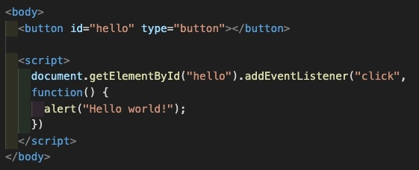
Adding JavaScript directly in HTML
Place JavaScript code between a pair of <script> tags

Slide 20
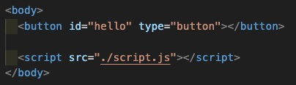
Linking an external JavaScript file to a web page
Still need a pair of <script> tags
Opening tag has src attribute whose value is the path to the external JavaScript file

Slide 21
Placing <script> tags
Can be placed in the HTML file within either the <head> tags or the <body> tags
Best to put within the <body> tags as the last element in the body
Putting within the <head> tags can cause JavaScript to run before the body of the web page is completely created
Can cause problems, errors, or unexpected results

Slide 22
Useful JavaScript Methods
alert();
Causes a box to pop up on the screen with whatever message is put in the parentheses alert(“Hi there!”);

Slide 23
Useful JavaScript Methods
prompt();
Same as alert, but also includes an input box for the user to type something in that will be saved in a variable or otherwise used in the code somehow let age = prompt(“Please enter your age: “);

Slide 24
Useful JavaScript Methods
console.log();
Prints into the browser’s console whatever is written within the method’s parentheses
Accessing the console
Hit F12 key or right-click on web page and click “Inspect” to open Developer Tools
Click on Console at the top of Developer Tools

Slide 25
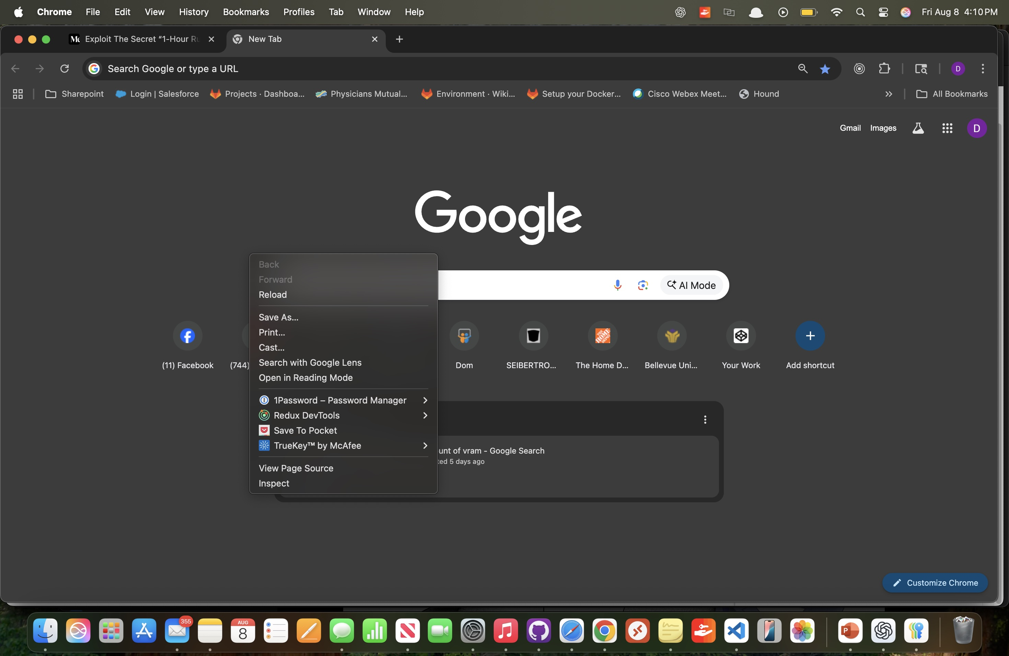

Slide 26
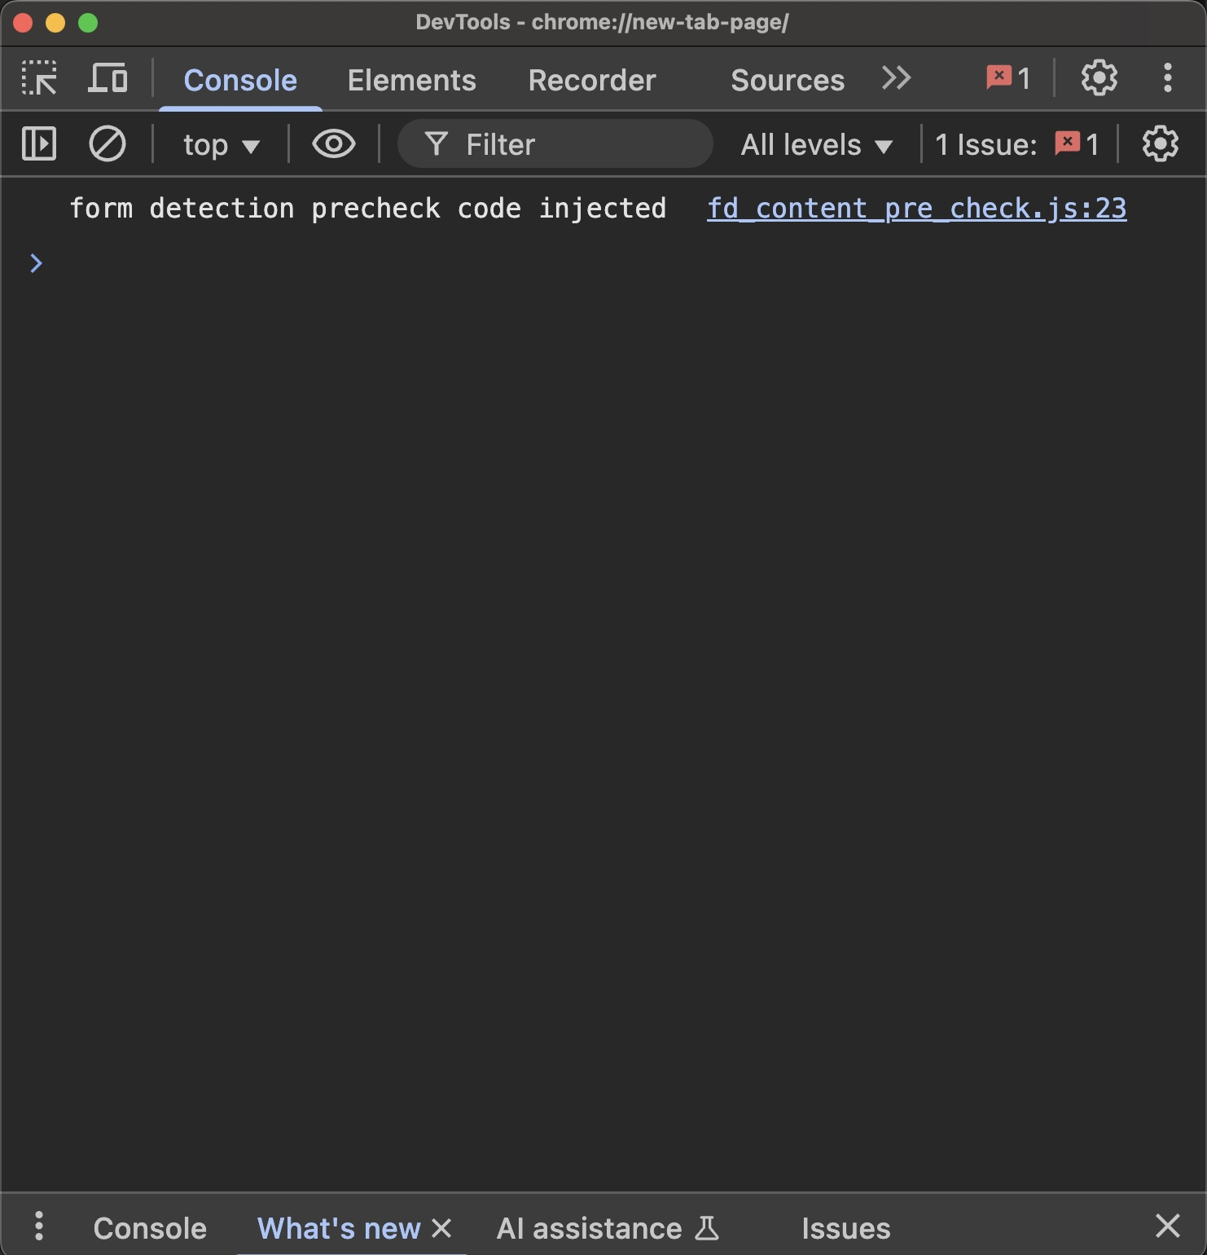

Slide 27
References
What is JavaScript?, MDN Web Docs, https://developer.mozilla.org/en-US/docs/Learn/JavaScript/First_Steps/What_is_JavaScript, accessed May 19, 2024.
Why JavaScript is called lightweight?, Subodh Kumar, JavaScript in Plain English, Jan 3, 2022, https://javascript.plainenglish.io/why-javascript-is-called-lightweight-5a1996db9ef6, accessed May 19, 2024.
Introduction to JavaScript, GeeksForGeeks, last updated Feb 2, 2024, https://www.geeksforgeeks.org/introduction-to-javascript/, accessed May 19, 2024.

Slide 28
References (cont’d)
Interpreted vs Compiled Programming Languages: What’s the Difference?, Free Code Camp, January 10, 2020, https://www.freecodecamp.org/news/compiled-versus-interpreted-languages/, accessed May 19, 2024.
Why is JavaScript Single Threaded?, Matt Long, Grove Technology, July 21, 2023, https://groovetechnology.com/blog/why-javascript-is-single-threaded/#:~:text=JavaScript%20was%20designed%20to%20be,interactivity%20to%20static%20web%20pages, accessed May 19, 2024.
Just in Time Compilation Explained, Free Code Camp, Feb 1, 2020, https://www.freecodecamp.org/news/just-in-time-compilation-explained/, accessed May 19, 2024.

